Slide 1
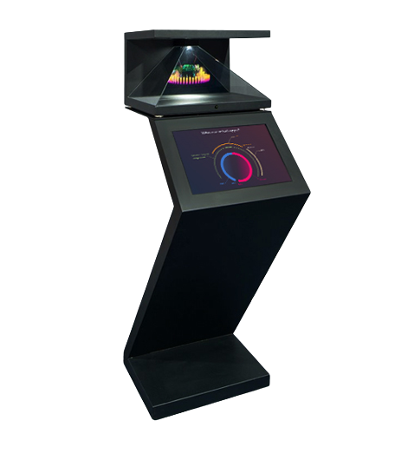
JEWEL’S DELIGHT
A PERSONAL TOUCH

Slide 2
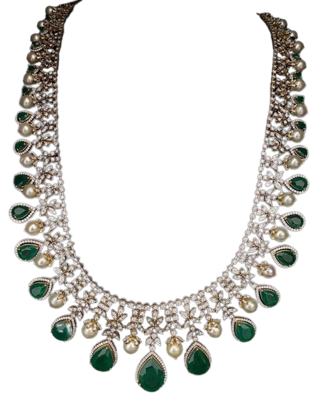
Jewelry is like the perfect spice – it complement what’s already there.
DIANE VON FURSTENBERG

Slide 3
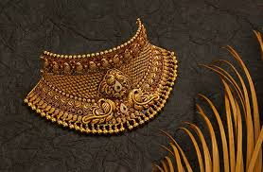
CONCEPT
VOICE ASSISTANT.
HOLOGRAM JEWELLERY.
VR TECHNOLOGY.
REGIONAL JEWELLERY.

Slide 4
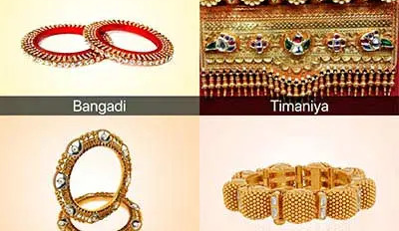
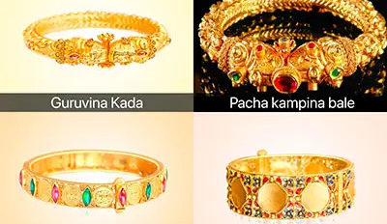
Introduction
Jewel’s delight is complete for solution for jewellery brand to provide there service in smarter way.
TWO MODE OF OUR SERVICE
WEBSITE
Website of jewel’s delight will have collection of jewellery’s( basically digital catalogue of jewellery ) by regional wise.
voice assistant which can engage customer in there mother tongue for more deep wibe.
Dies management of jewellery design (only for business owner)

Slide 5
Introduction
Second mode
ROBO MACHINE
Display screen(tablet) for easy exploration in jewel’s world.
Hologram technology to view actual dimension of virtual article in physical world.
VR technology to take feel that how will that jewellery look on customer.

Slide 6
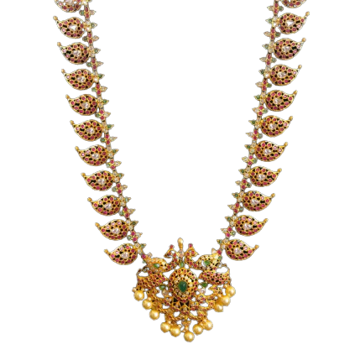
Content
REGIONAL JEWELLERY
Voice assistant
Regional jewellery collection on one click.
In this section background will be according to regional jewellery to enhance ambiance.
By this customer will get less distracted from there need and can see more article by there liking.
Voice assistant can tell same information in detail many time.
Voice assistant can interact in preferable language.
Interaction in preferable language make more effect in customer satisfaction by psychological effect.

Slide 7
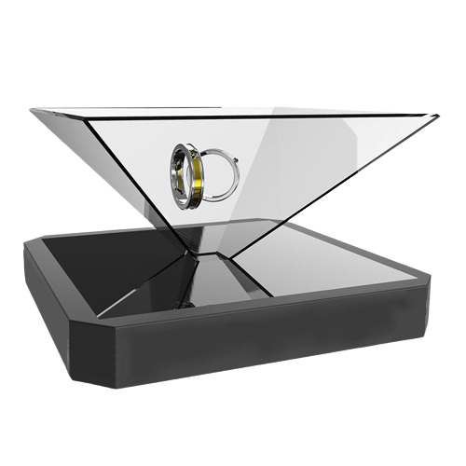
Content
Hologram technology
VR technology
Customer can see dimension of select article in physical world by virtual mean.
3d perception create more realistic view in human brain as compare to 2d perception.
Customer can see there select article in virtual world before investing huge amount and can make change before manufacturing process.
When try some thing which have to buy then our vision get more clear.
But one jewelry shop can’t have all design.
So, use of vr technology help us to try select product virtually.
Then customer can change presence of product accordingly.

Slide 8
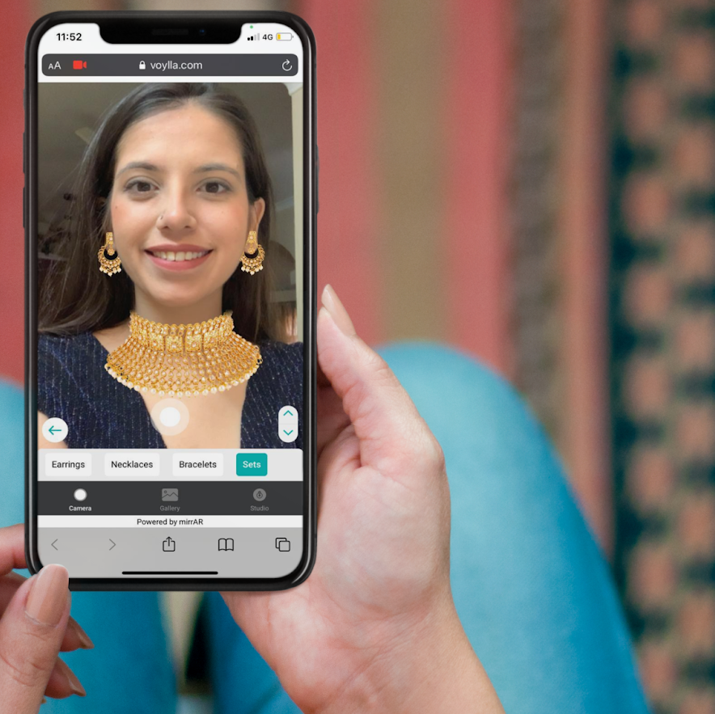
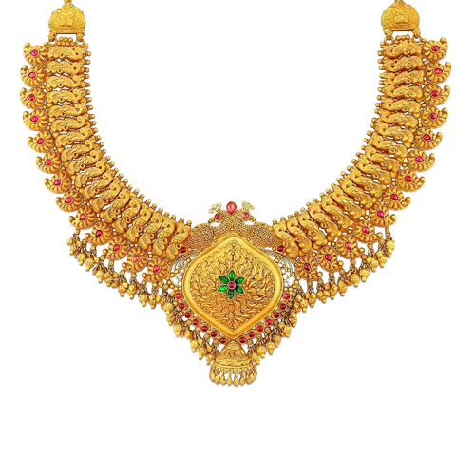
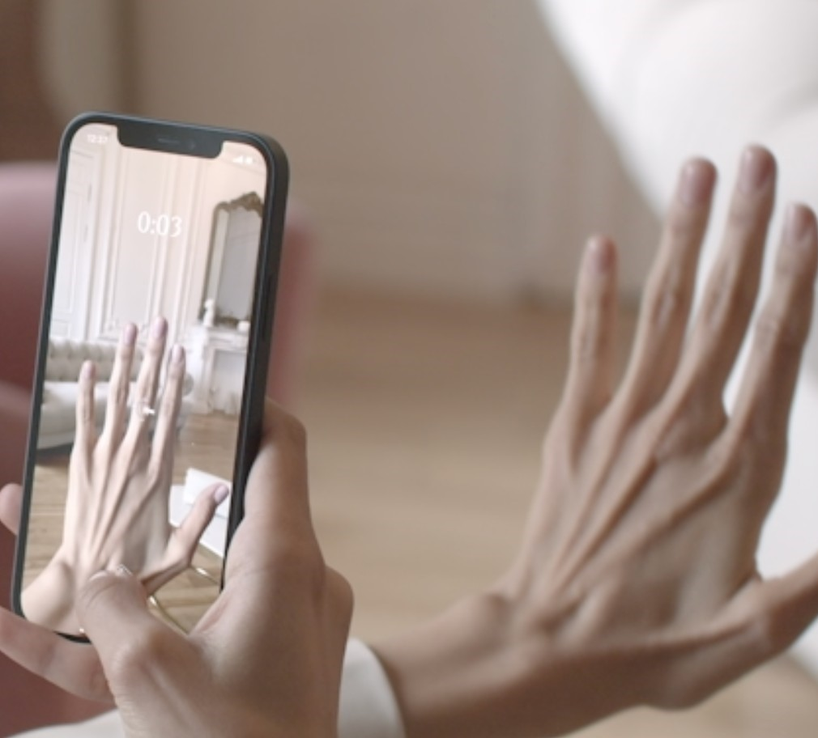
Summary
With PowerPoint, you can create presentations and share your work with others, wherever they are. Type the text you want here to get started. You can also add images, art, and videos on this template. Save to OneDrive and access your presentations from your computer, tablet, or phone.

Slide 9
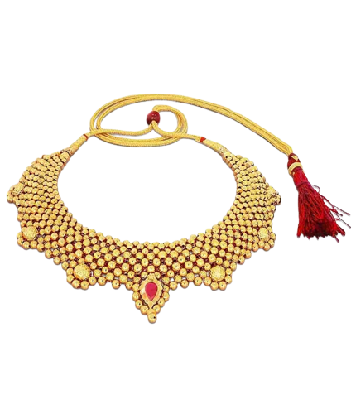
THANK YOU
CHOUDHARY SURESH

